Slide 1


Mohammad Mahmoodian
Title: ADMM
abstract
Boyd
Berekly
4
5

Slide 2


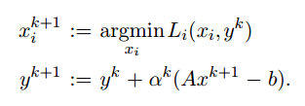


Mohammad Mahmoodian
Title: ADMM
abstract
Boyd
Berekly
4
5

Slide 3
Mohammad Mahmoodian
Title: ADMM
abstract
Boyd
Berekly
4
5

Slide 4
Mohammad Mahmoodian
Title: ADMM
abstract
Boyd
Berekly
4
5

Slide 5
Mohammad Mahmoodian
Title: ADMM
abstract
Boyd
Berekly
4
5

Slide 6
Mohammad Mahmoodian
Title: ADMM
abstract
Boyd
Berekly
4
5

Slide 7
Mohammad Mahmoodian
Title: ADMM
abstract
Boyd
Berekly
4
5

